Slide 1

HABITCONNECT
COSC 4P02 FINAL
PROJECT PRESENTATION
Tuesday April 23rd, 2024
TA: Brendan Park

Slide 2
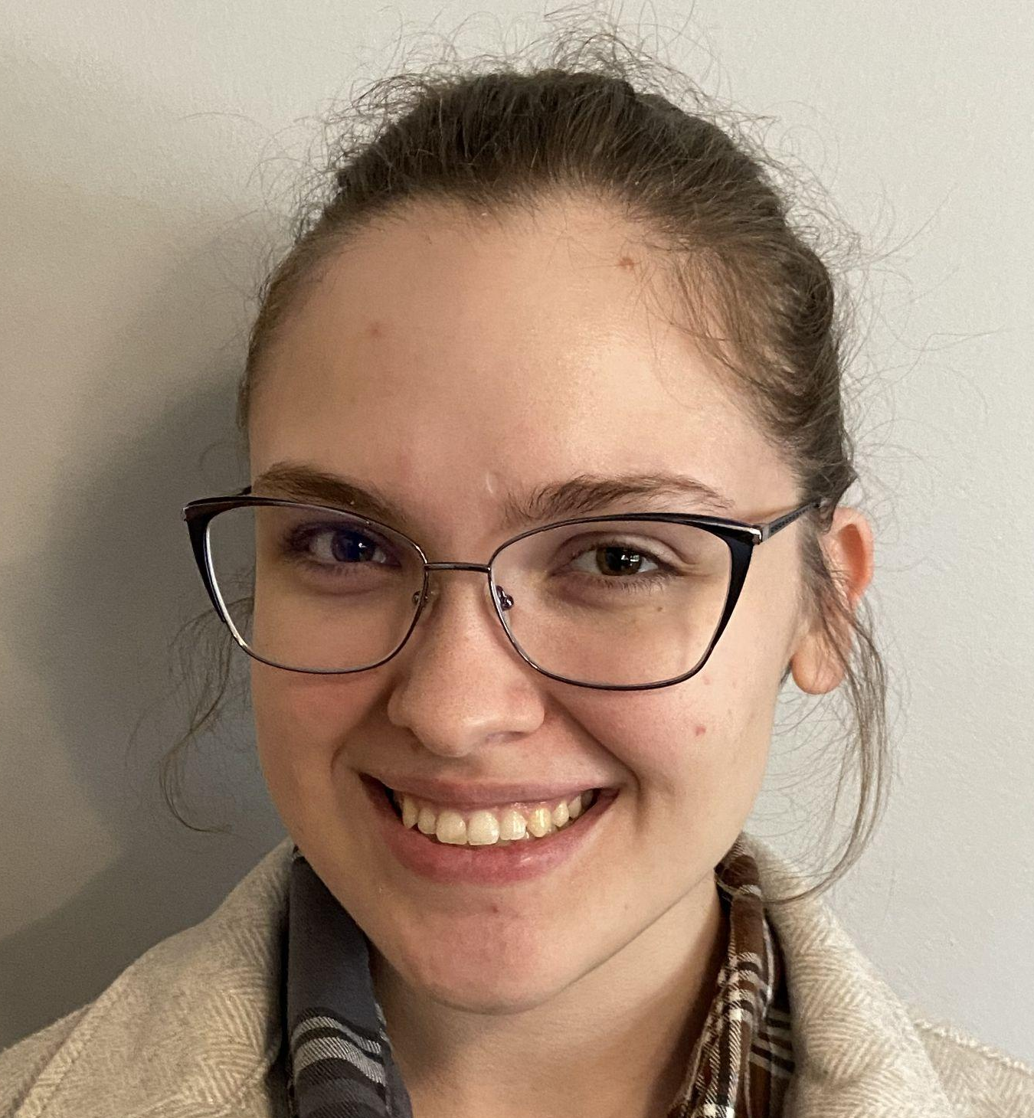

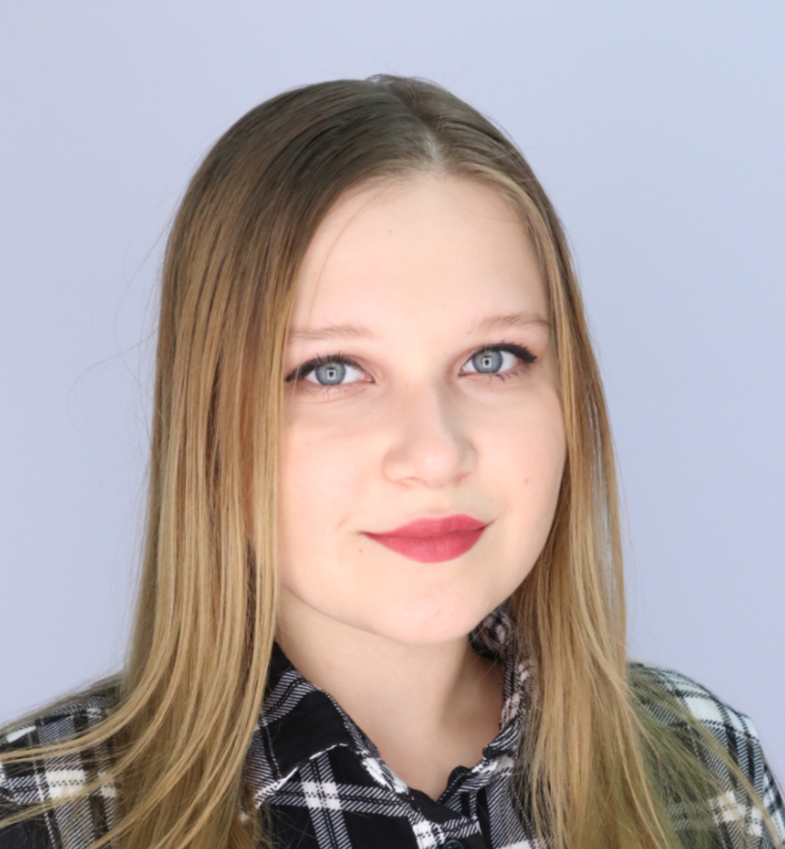
EXECUTIVE TEAM
Meet the Team
Kacie Phillippo
Scrum Master
(6877591)
Muiz Odebiyi
Product Owner
(6849509)
Elya Denysova
Project Manager
(6667596)
- Led meetings
- Meeting notes
- Documentation
- Report completion
- Manual testing
- Web page design
- Priority
management
- Front-end
development
- Emailing
functionality
- Priority
management
- Jira management
- Front-end
development
- Web page design

Slide 3
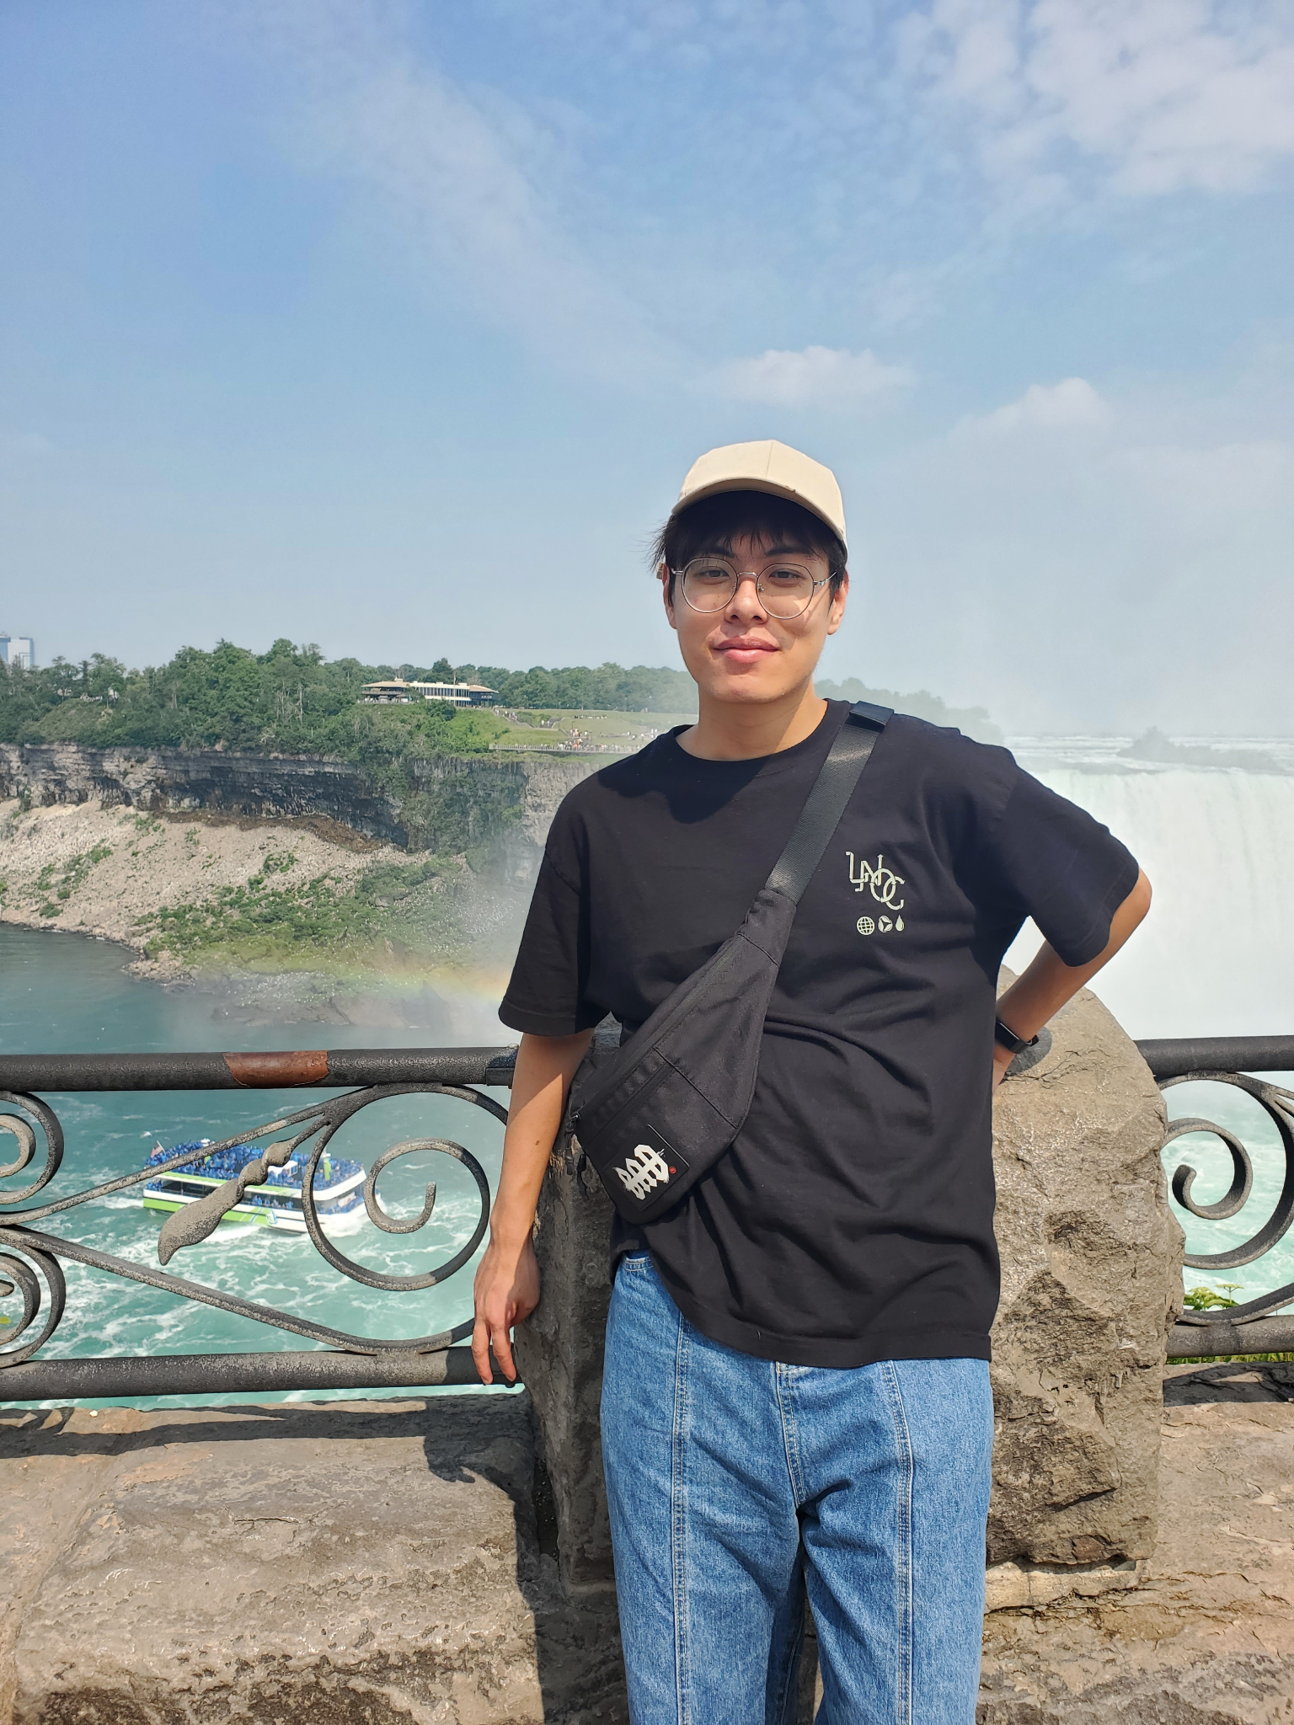
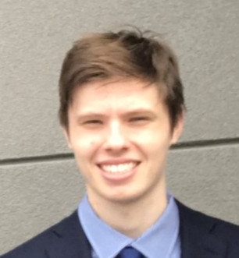
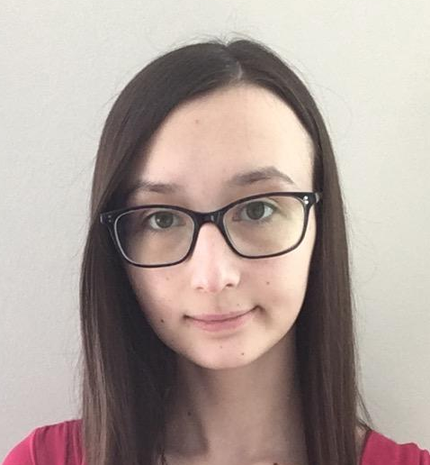
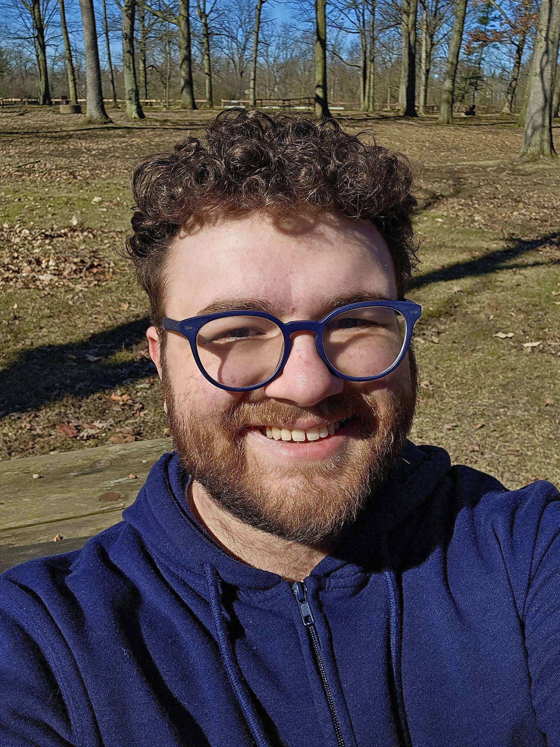
FRONT-END TEAM
BACK-END TEAM
Yifan Zhu
Front-End Lead
(7345671)
Maxwell Young
Front-End Lead
(6769608)
Lysa Hannes
Back-End Lead
(6695100)
Robert Pierik
Back-End Lead
(6773832)
- Front-end
development
- Debugging
- Front to back-end
connectivity
- Front-end
development
- Pop-up creation
- Page
beautification
- Back-end
development
- Database design
and management
- Documentation
- Automatic testing
- Back-end
development
- Database design
and management
- Automatic testing

Slide 4
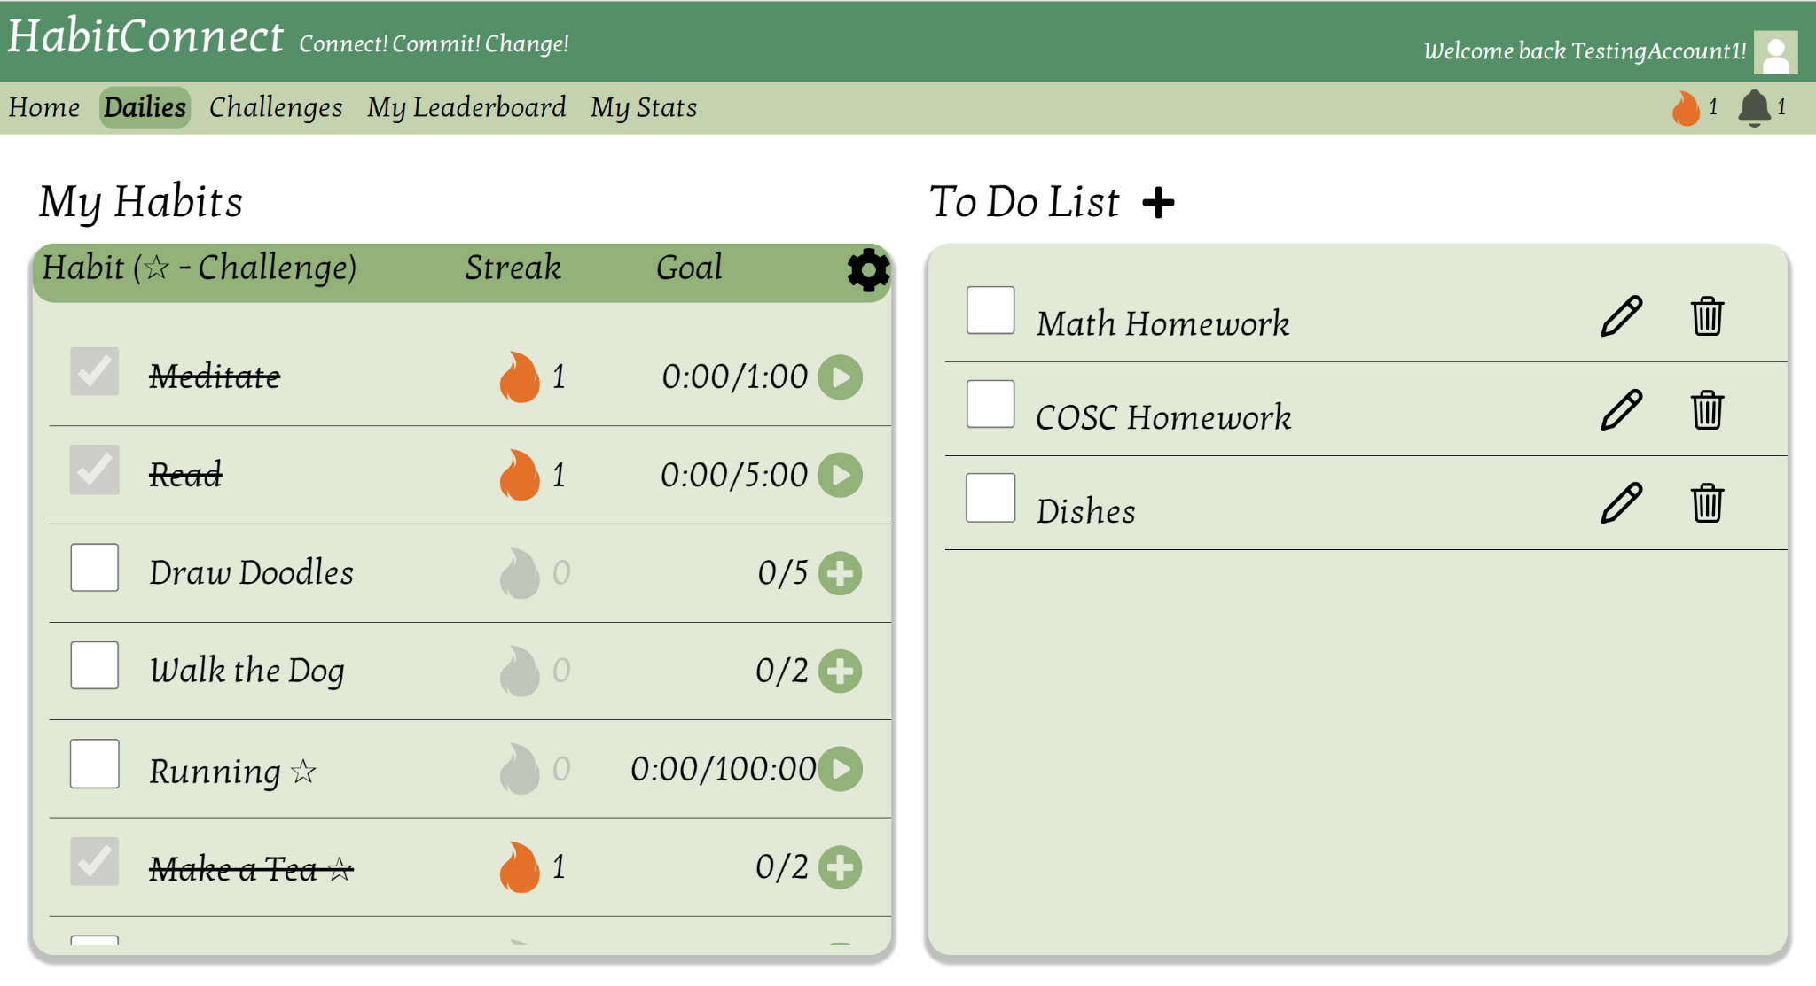
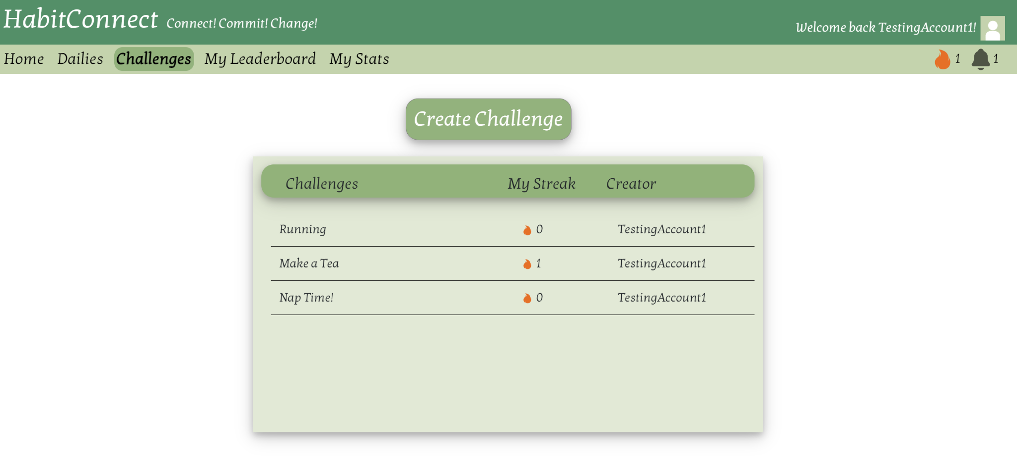
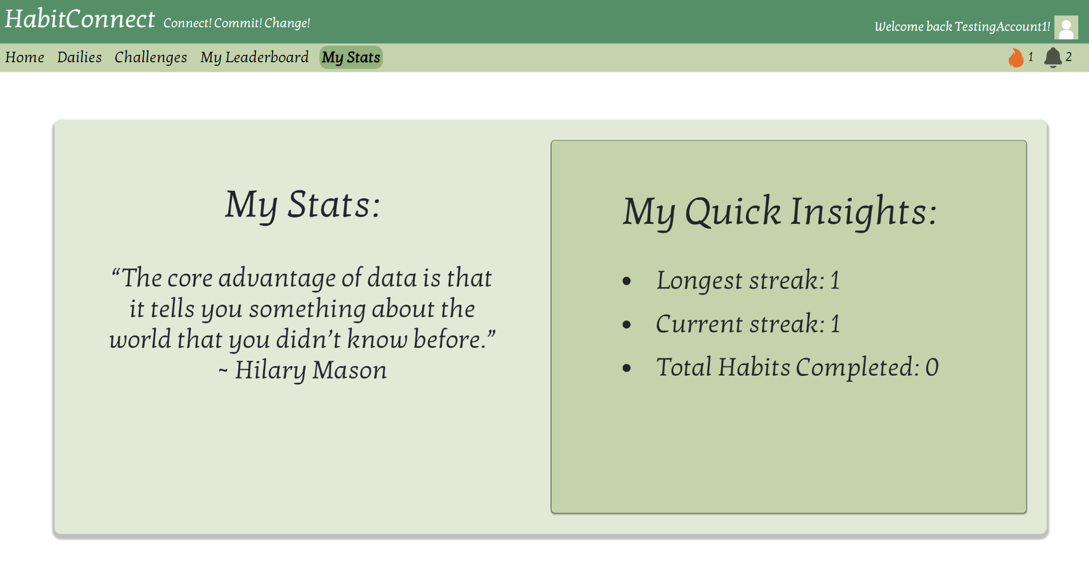
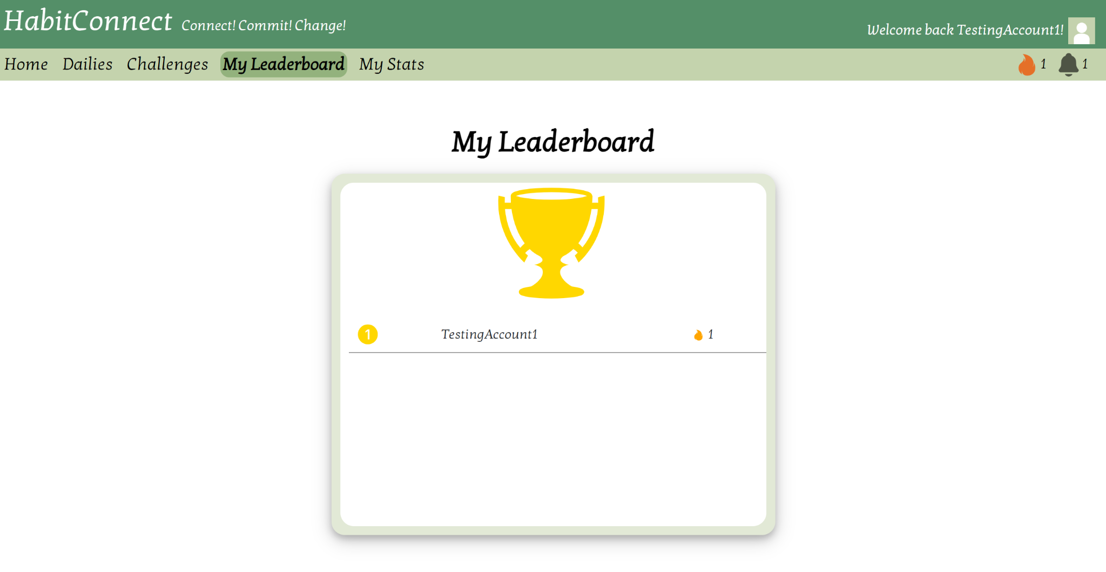
WHAT IS HABITCONNECT?
An online, habit tracking website designed to cultivate positive habits and monitor individual progress. The website prioritizes user-friendliness and ease-of-use.
It empowers users to establish positive goals through daily streaks, reminders, motivational quotes, and group challenges.
Users link their email to their account for use from any device. A comprehensive statistics page allows the user to track personal progress.

Slide 5

WHY HABITCONNECT?
There is an increasing desire and need for a shift towards healthier habits
Taking action amid busy schedules or forgetfulness makes this difficult
We aim to provide a tool which makes monitoring daily habits easy and convenient
Notes:
Project felt close to us with our busy schedules

Slide 6
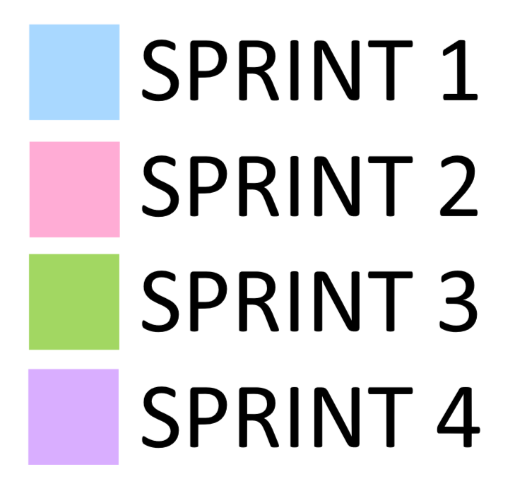
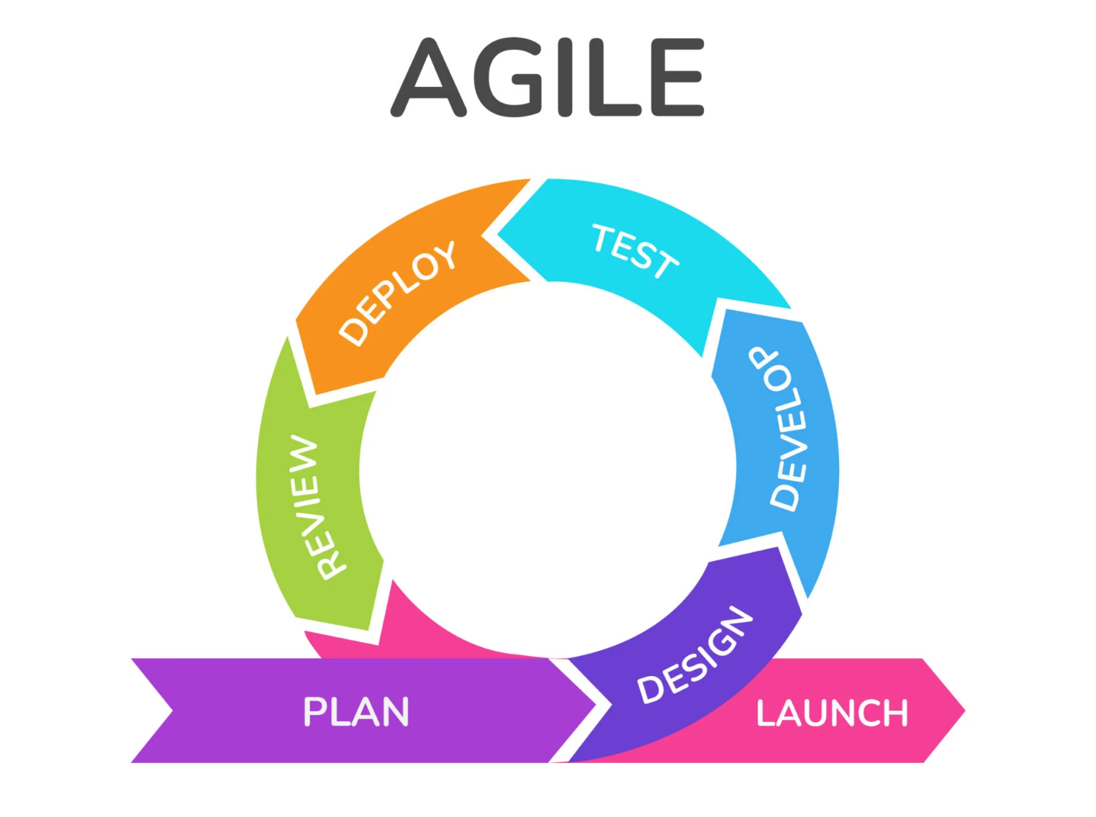
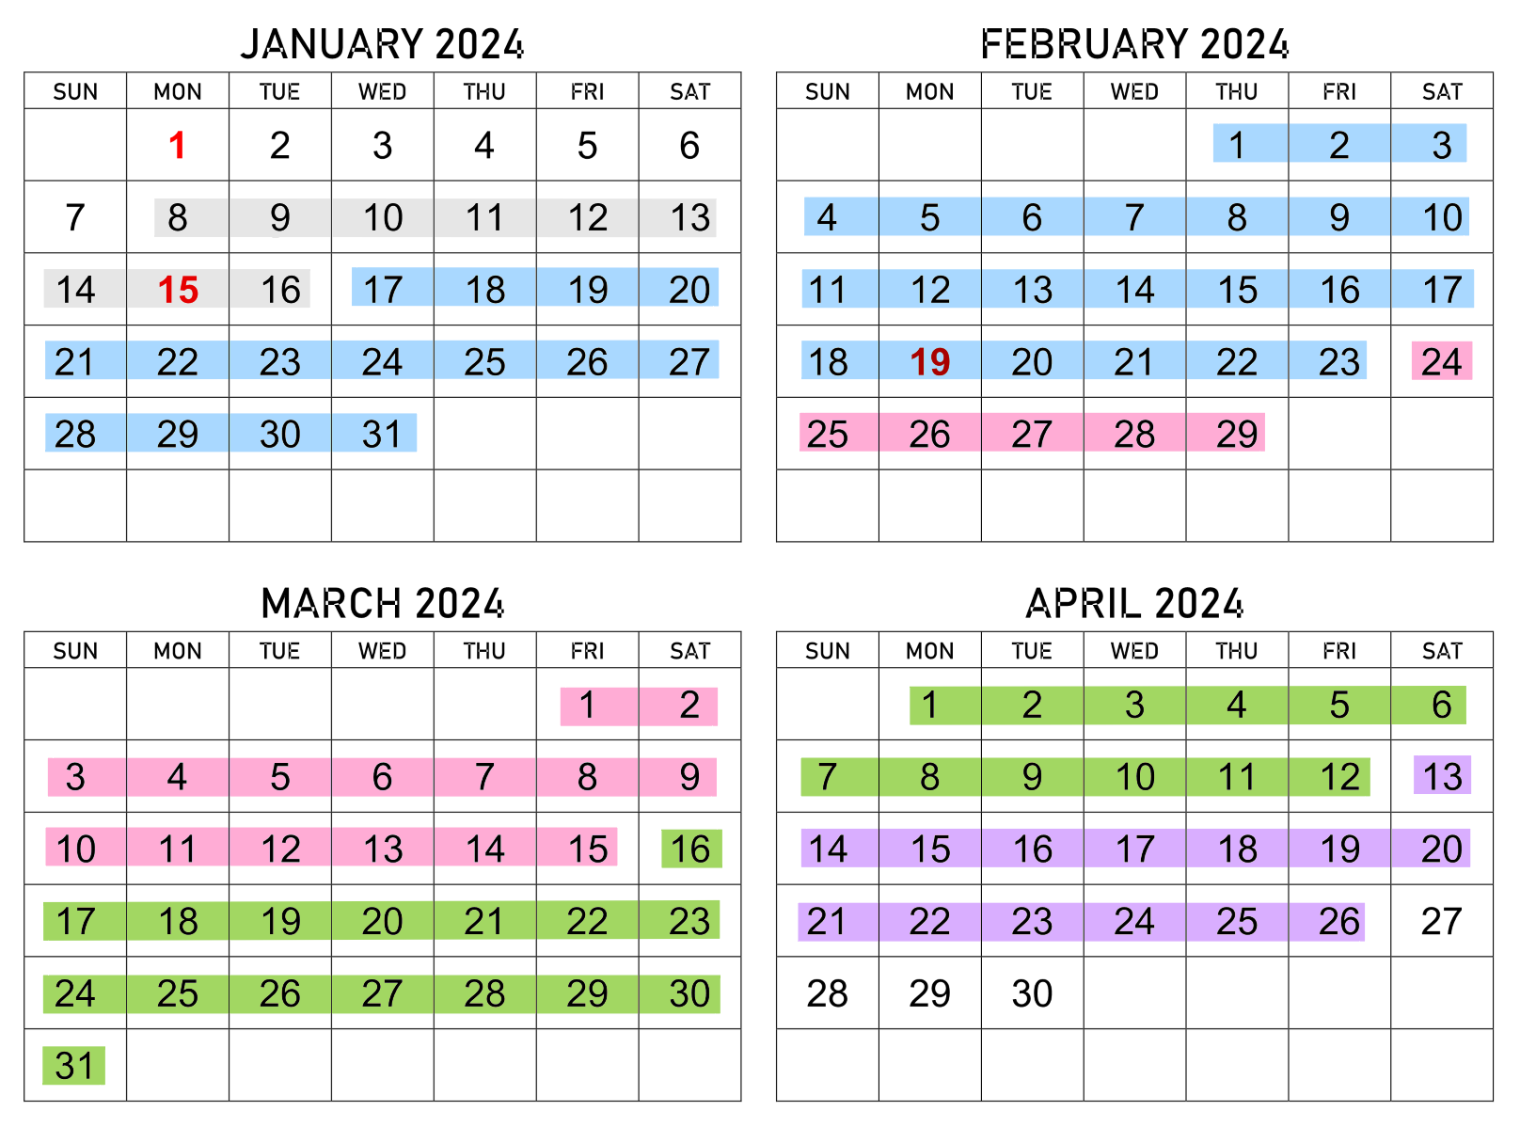
SOFTWARE ENGINEERING PROCESS
SPRINT SCHEDULING
Modified agile development process
MEETING SCHEDULING
“Daily” scrum meetings twice a week
Sprint planning meetings
Sprint review meetings
Sprint retrospective meetings
All meetings have detailed notes on our GitHub

Slide 7





SOFTWARE ENGINEERING TOOLS
GITHUB
Version control, collaborative development, software project storage, branching development
JIRA
User story management, task assignment and planning, sprint management, project management
FIGMA
Web page design, brainstorming and planning, note taking
DISCORD
Meeting space, between meeting communication, bug tracking, important information tracking
GOOGLE DRIVE
File storage, collaborative workspace for documentation

Slide 8
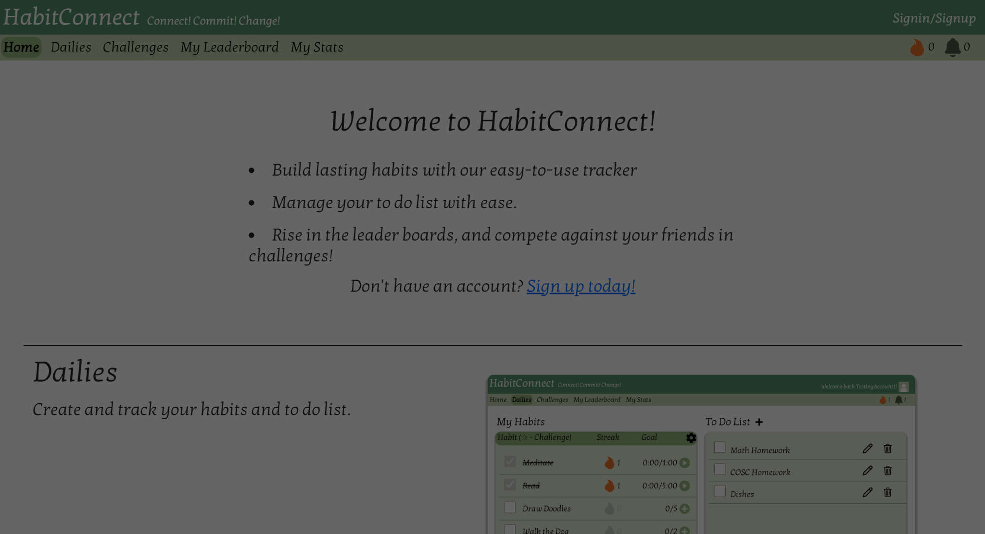
SITE DEMONSTRATION

Slide 9
TECHNICAL ISSUES
Known Issues on the Website
The Dailies page has multiple known problems, from tracking streaks across multiple days to updating check-in data in the back-end appropriately.
Some pages open with warnings in the console upon first load.
Some of the pages are not compatible with zooming within the browser, and other pages could be improved in their scalability.
Time field for creating habits can only accept values in seconds, not minutes/hours.
Our manual testing document stores a few more known bugs for front-end issues.
What Could be Improved?
Most pages could be improved in their responsiveness to zooming and different screen heights and widths.
Accessibility and customization features would have been a positive addition.
Some of the pages could use more consistent design features and font sizing.
We want to include a date picker within the Dailies page, to view long term progress.

Slide 10
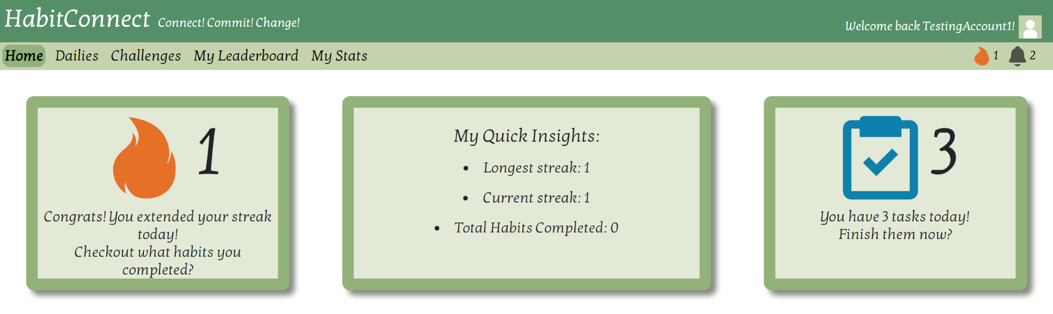
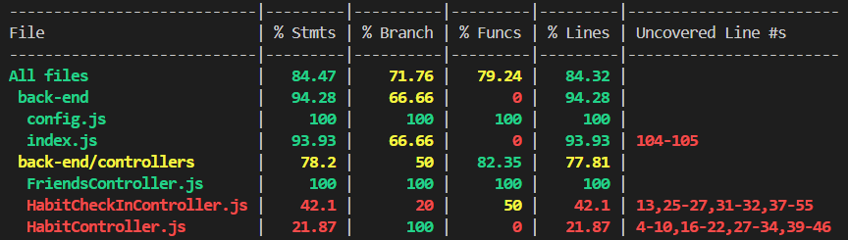



FRONT-END
React.js,
UI-library: Reactstrap
TECHNICAL BREAKDOWN
BACK-END
Node.js
Express.js
DATABASE
MongoDB

Slide 11
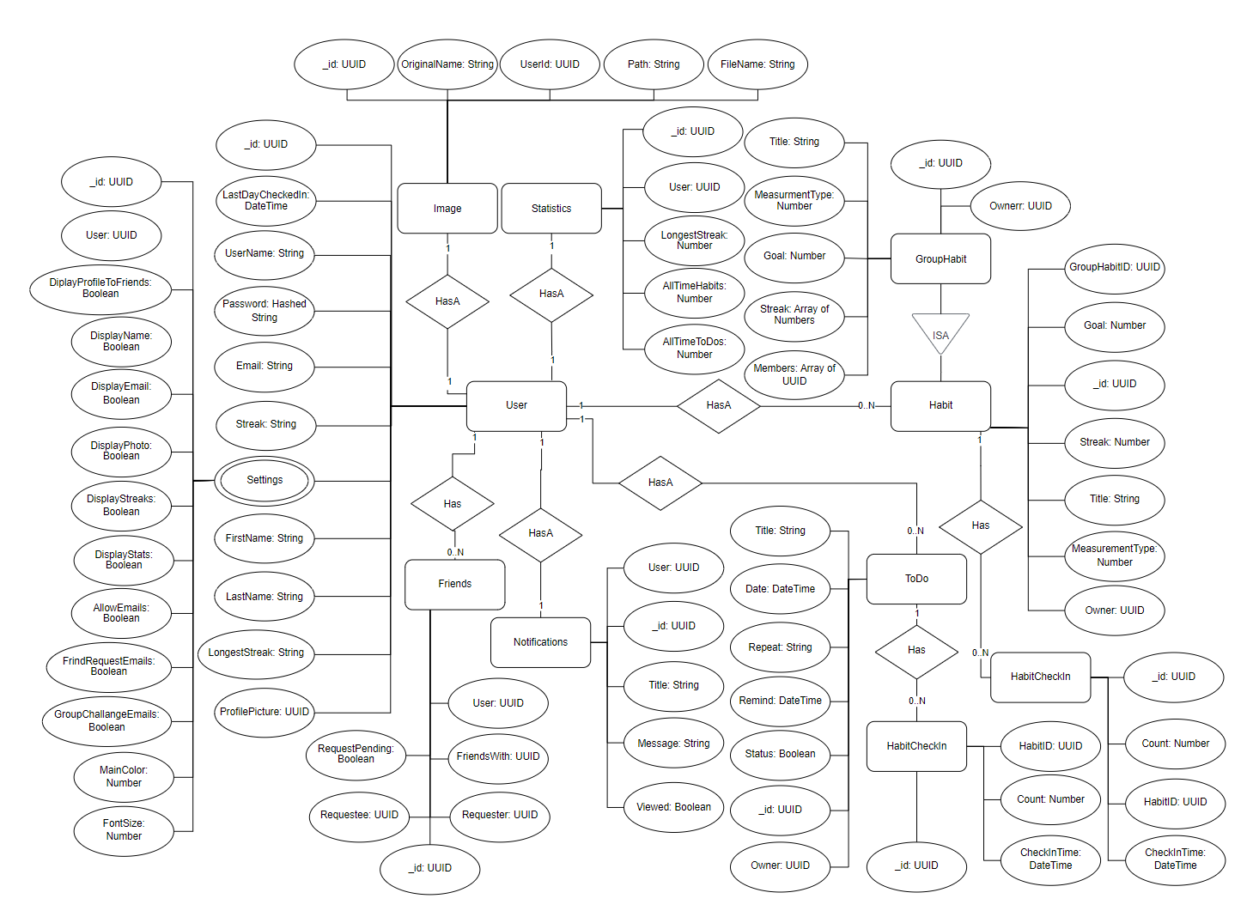
ER DIAGRAM

Slide 12
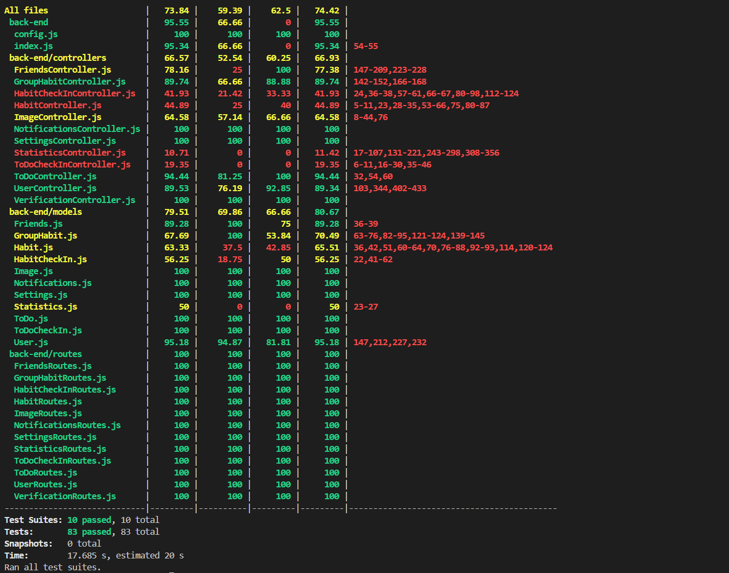
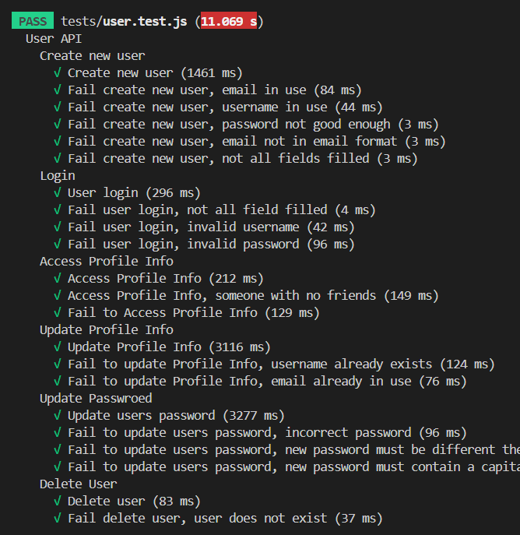
AUTOMATIC TESTING
Notes:
In the backend, we created many automatic tests. Automatic testing is extremely important because it goes through every single possible case, catching any problems that manual testing might miss, and ensuring nothing is negatively impacted when we push new changes. Additionally it does this within a matter of seconds, making testing super fast and easy, once it’s set up.
We used Jest for this. Jest is an amazing dependency. As you can see on the right of the screen, jest gives a full coverage report for all the files in the backend. For our testing file structure, we made a separate test file for every schema. Looking over at the picture on the left, you can see we formatted our test names so you can easily see which api’s have been tested and what was tested for each api.
There are a couple api’s that we were unable to test automatically. These include all the api’s that send emails, because sometimes they would time out, and this caused inconsistencies in our results. Also, the upload image api was unable to be tested automatically since we couldn't find a way to send an image in an automatic test. But both of these exceptions were tested rigorously using manual testing so these cases were still covered.

Slide 13
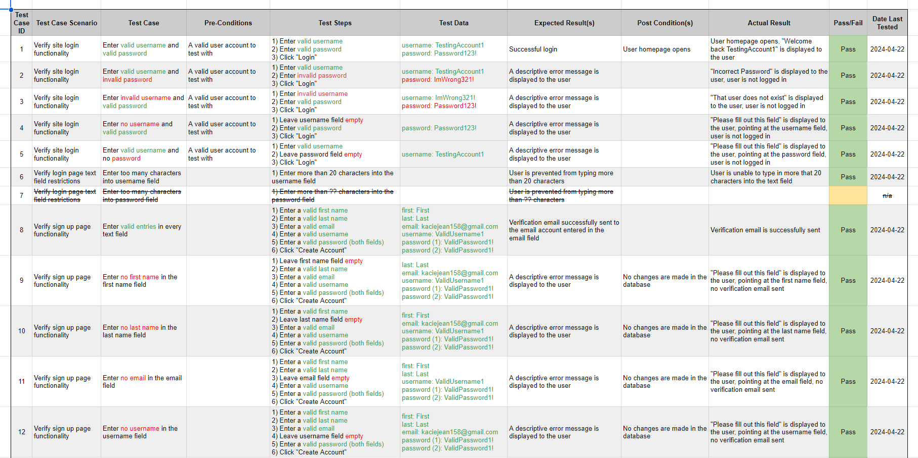
MANUAL TESTING
We completed 59 manual test cases across the following pages:
Sign up page
Sign in page
Dailies page
User profile page
53 of these test passed upon recent manual completion.
Notes:
Our automatic testing was extensive, but being a user driven website, we knew it was important to have extensive manual testing also. We created a master spreadsheet filled with all of our manual test cases, including steps to perform them and sample data. We completed manual testing on all pages where users needed to provide input, including the sign up, sign in, dailies, and user profile pages. We have 59 tests in total, where 53 are passing. We also had plans to specifically focus on other kinds of testing for the front-end, including accessibility, cross-browser, and performance testing.

Slide 14

Close adherence to the software engineering process, and detailed documentation
Extensive and detailed front-end and back-end design before implementation
Comprehensive manual and automatic testing, providing substantial coverage
SUCCESSES
Managing responsibilities with the weight of our other courses
Learning each others knowledge and skill levels
Task scheduling, prioritization, and completion on deadlines
CHALLENGES
Notes:
Due to lack of experience, we often found it difficult to have best estimations of deadlines and meeting them with weight of other courses

Slide 15
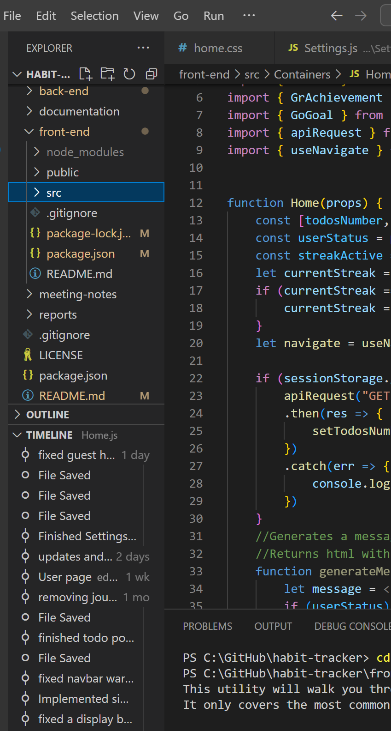
WHAT DID WE LEARN?
How to work as part of a software development team. Collaborative coding, assignment and delegation of tasks, constant communication, and meeting/presentation skills.
Agile software development, including tools available to us (GitHub, Jira, Figma) as well as the workflow and importance of frequent, clear communication of tasks and abilities.
The workflow of a development team and the software engineering process. The importance of design, best methods of implementation, and the strength of automatic testing.

Slide 16
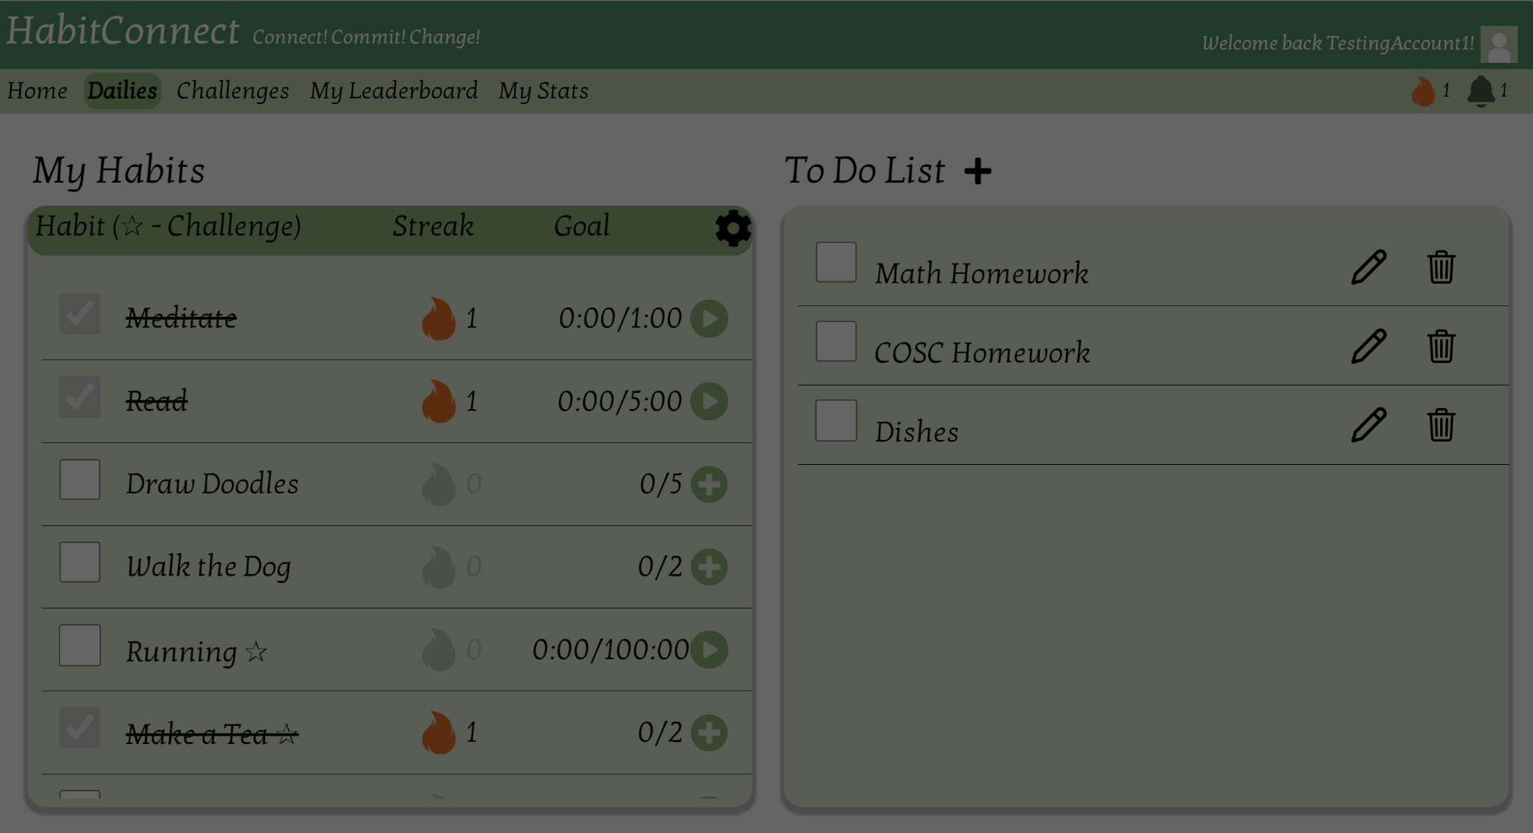
THANK YOU
Time for a Q&A Session

